Slide 1

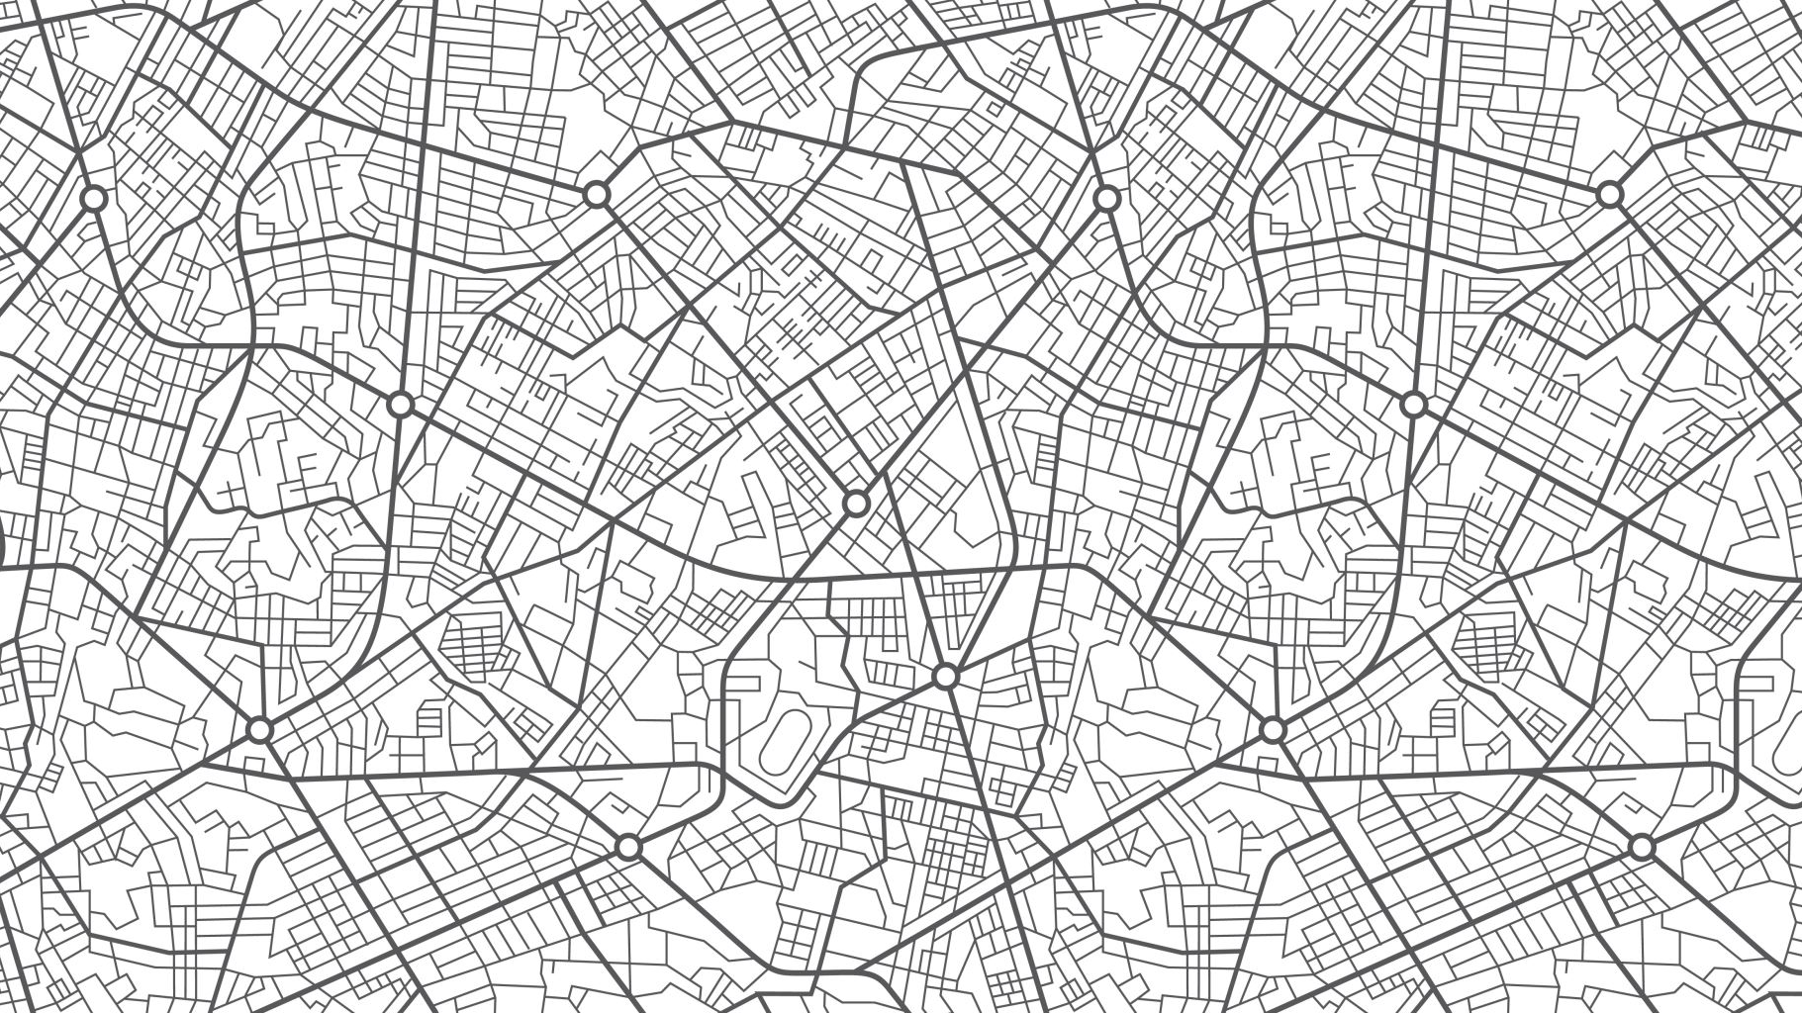
Mapping Parkinson’s with python
Sebastien Girard
Zac LeGros
Matthew Tran

Slide 2

Parkinson’s disease
Affects nerve cells that transmit dopamine
Symptoms: tremors, speech and gait impediments, muscle rigidity
No Know treatment, but early detection can help treat symptoms

Slide 3
Predicting Parkinson’s with Machine Learning
SciKit Learn and OpenCV python libraries
Based on patients draw, can predict with 85% accuracy the likelihood of developing Parkinson’s

Slide 4
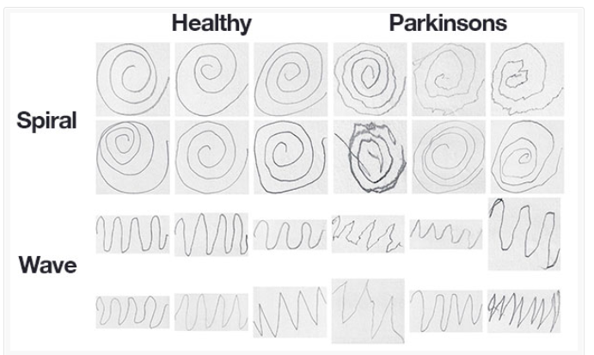
Data set example
Taken from NIATS of the Federal University of Uberlandia (2019)

Slide 5
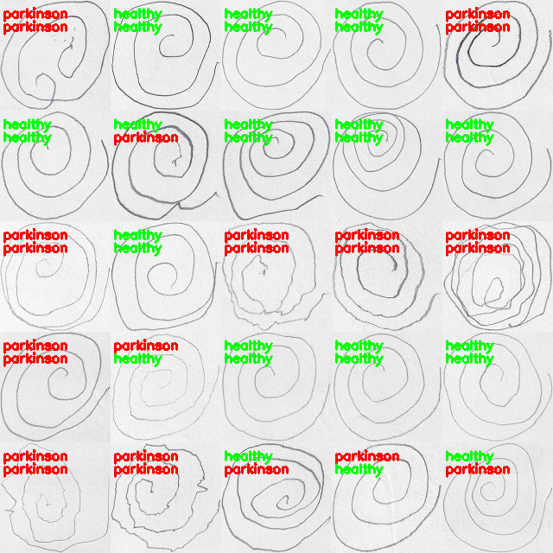
Above: Prediction
Below: actual result
Data-sets can also be retrained as they go

Slide 6
Our solution
TO_DO add photos of app
Doctors can prescribe test to patient through unique email link
Will then process and send results securely for doctor to review and follow-up on through Node API

Slide 7
Next steps
Add functionality to integrate other advanced diagnosis tests (ex. Autism, Huntington’s, Dementia)
Improve security and privacy policies for patient confidentiality

Slide 8
Sources
Original article on Parkinsons identification using composite indexes: https://www.frontiersin.org/articles/10.3389/fneur.2017.00435/full
Spiral wave python: https://www.pyimagesearch.com/2019/04/29/detecting-parkinsons-disease-with-opencv-computer-vision-and-the-spiral-wave-test/

